Slide 1


K. RAMAKRISHNAN COLLEGE OF ENGINEERING
(AUTONOMOUS), SAMAYAPURAM – TRICHY
DEPARTMENT OF ARTIFICIAL INTELLIGENCE AND MACHINE LEARNING
CGB1221 DATABASE MANAGEMENT SYSTEM
LIBRARY MANAGEMENT SYSTEM
PRESENTED BY SUPERVISOR
SRI KARUNYA S S K Mr. P.Nagaraj, M.E.,
8115U24AM052 Assistant Professor / AI&ML
Date of Review : 06.05.2026

Slide 2
PRESENTATION OVERVIEW
Objective
Problem Analysis
System Architecture
Methodology
Entities Used
Modules
Implementation
Conclusion
Future Scope

Slide 3
OBJECTIVE
To automate library operations
To maintain book details in a structured database
To manage members, staff, issue, and return records
To reduce errors in manual record keeping
To provide quick search and easy report generation

Slide 4
PROBLEM ANALYSIS
Manual library management takes more time
Maintaining records on paper can lead to loss of data
Searching for books and member details is difficult
Issue and return tracking becomes confusing
Fine calculation and report preparation are not easy manually

Slide 5
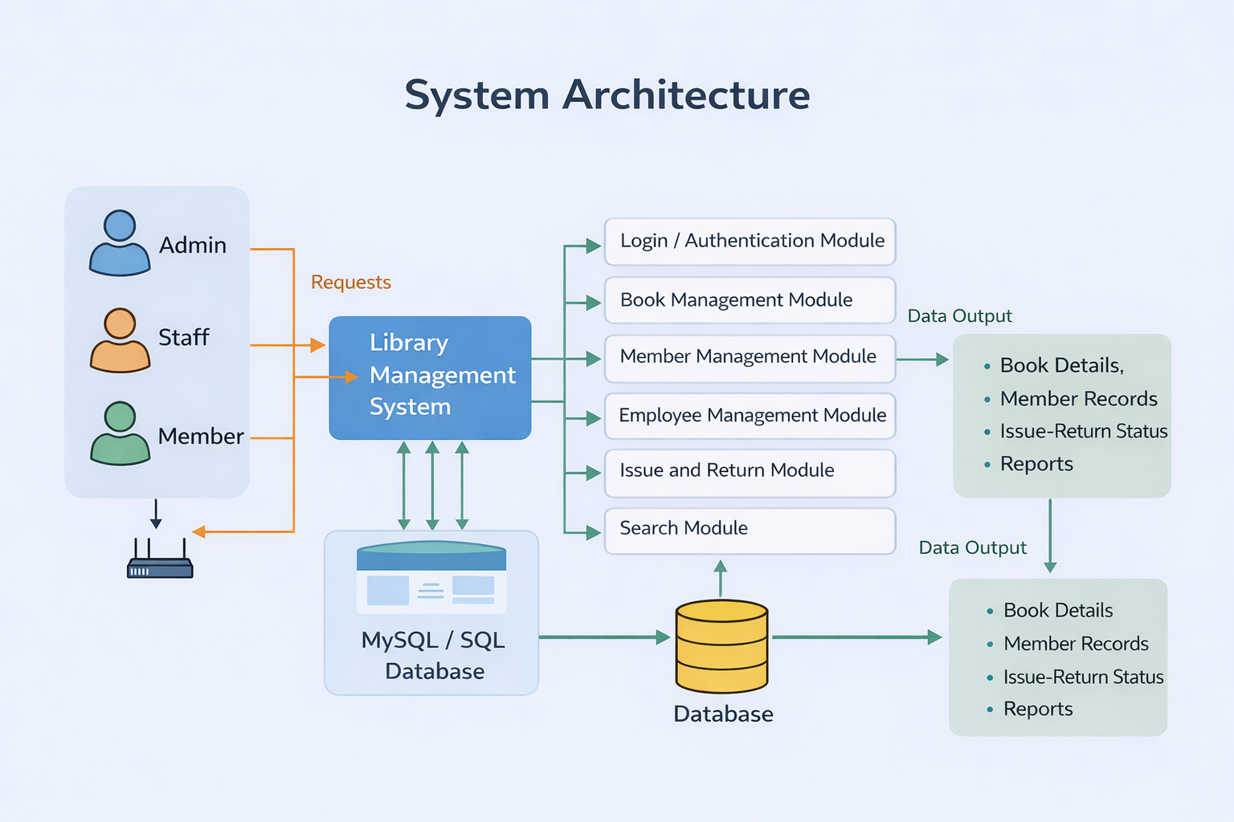
SYSTEM ARCHITECTURE

Slide 6
METHODOLOGY
Requirement collection
Database design using ER model
Entity and attribute identification
Table creation and relationship mapping
Form design for data entry
Query design for retrieval and reports
Testing and validation

Slide 7
ENTITIES USED
Based on Library Management System entities and attributes
Entities: Admin, Employee, Member, Books, Author, Publisher,
Vendor, Library
Attributes include: ID, Name, Contact Number, Address, Book Status,
Book Price
Used for maintaining library records in a structured database

Slide 8
MODULES
Admin Module: Controls the overall library system and manages employees and records.
Employee Module: Handles day-to-day library operations and manages member requests.
Member Module: Stores and manages member details and library usage information.
Books Module: Maintains book records, price, and availability status.

Slide 9
5.Author Module: Stores details of authors related to books. 6.Publisher Module: Manages publisher information for books. 7.Vendor Module: Stores vendor details for book supply. 8.Library Module: Maintains overall library information such as name, address, and contact details.
MODULES

Slide 10
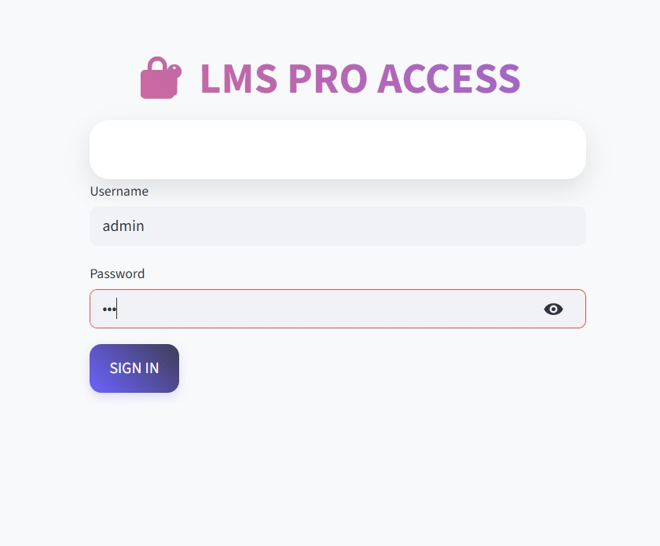
IMPLEMENTATION
FRONT END DATABASE

Slide 11
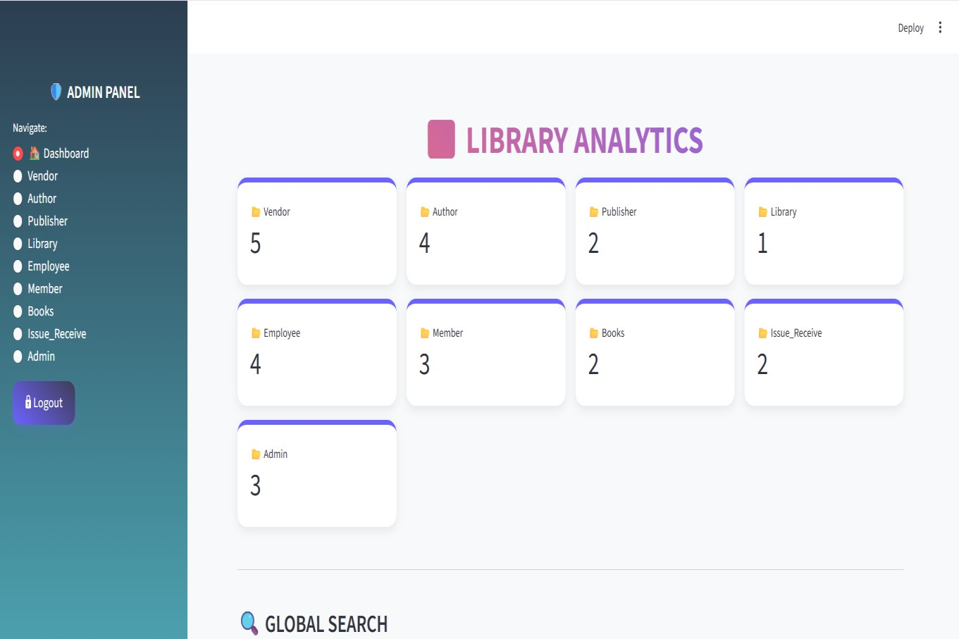
IMPLEMENTATION

Slide 12
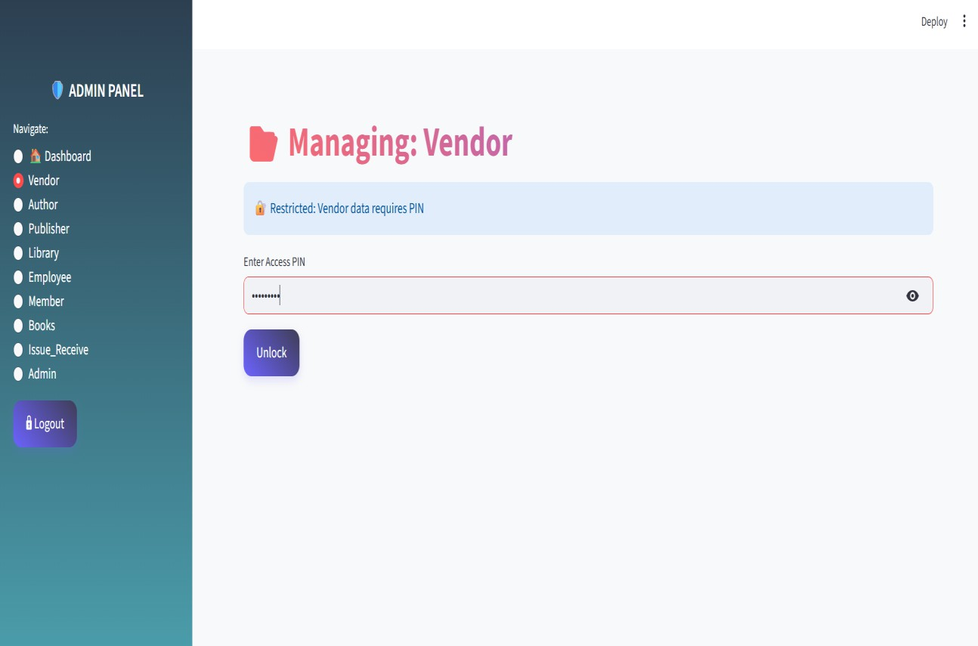
IMPLEMENTATION

Slide 13
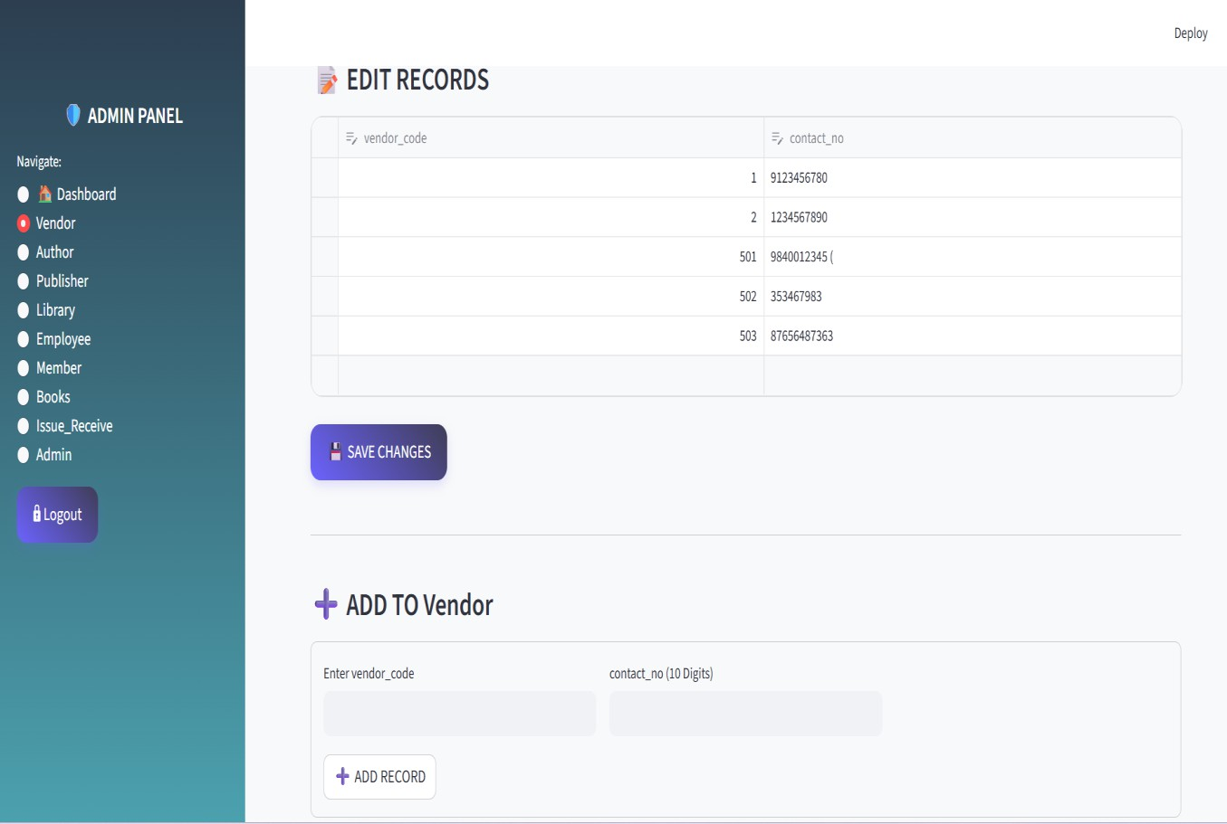
IMPLEMENTATION

Slide 14
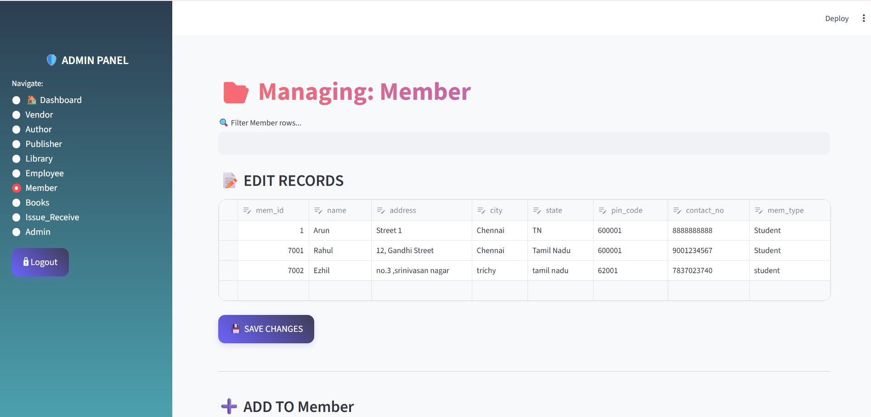
IMPLEMENTATION

Slide 15
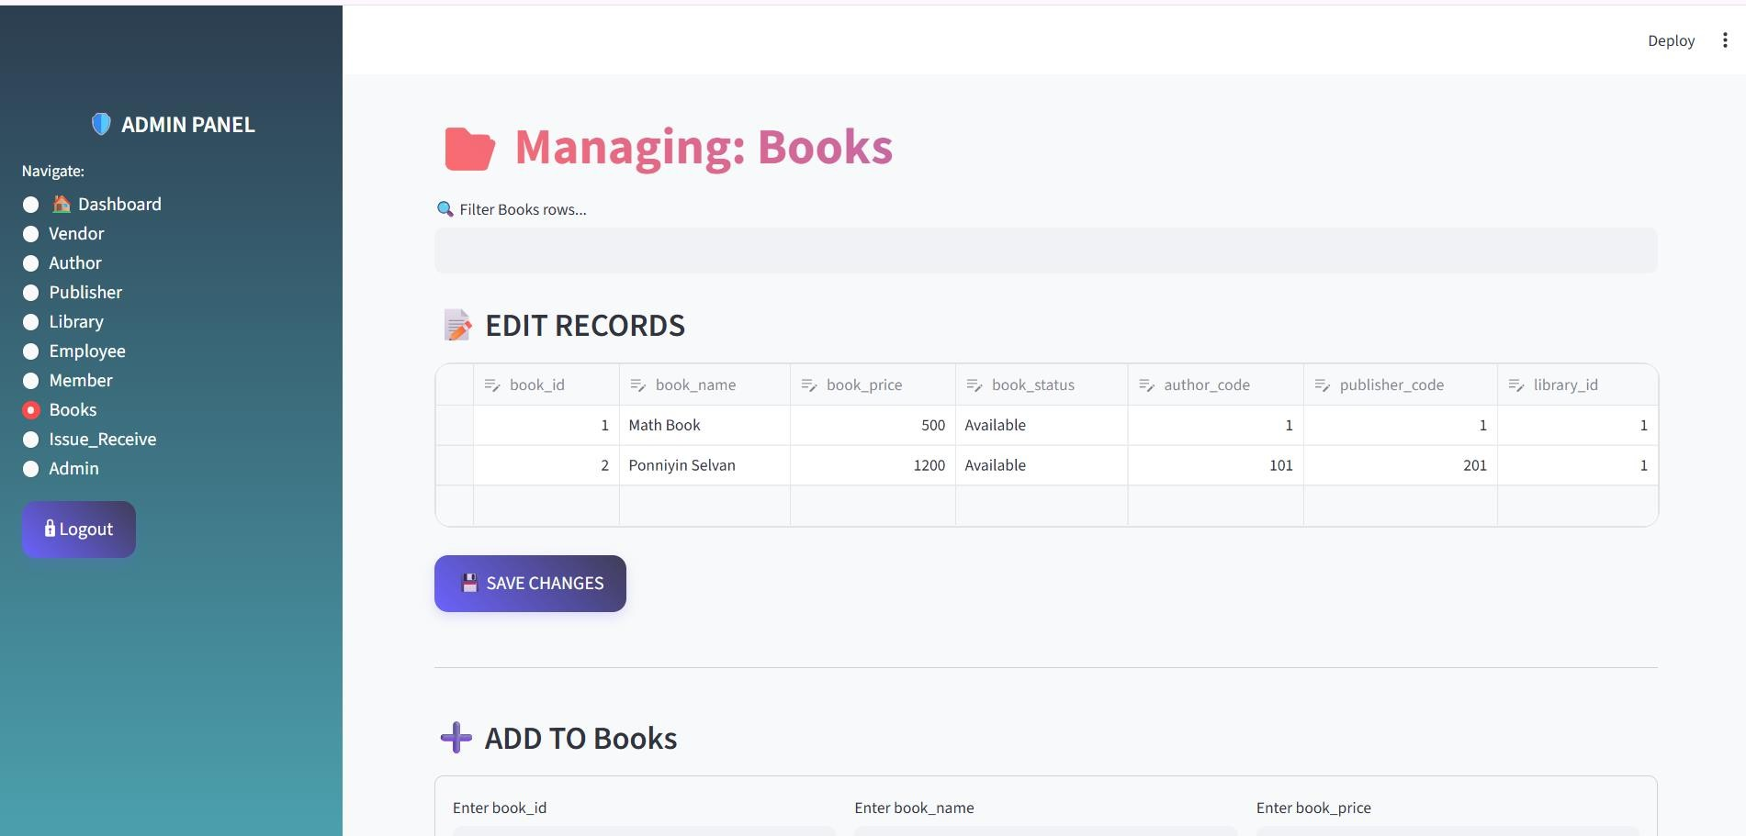
IMPLEMENTATION

Slide 16
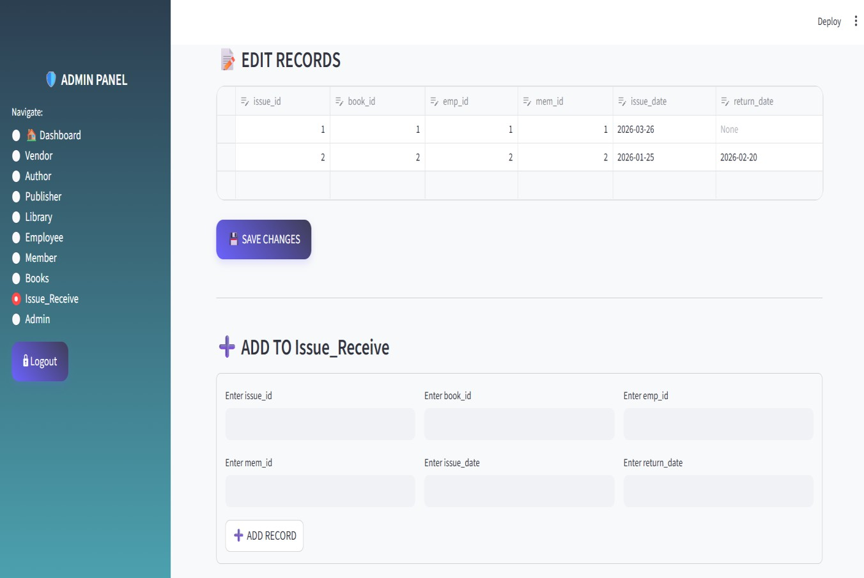
IMPLEMENTATION

Slide 17
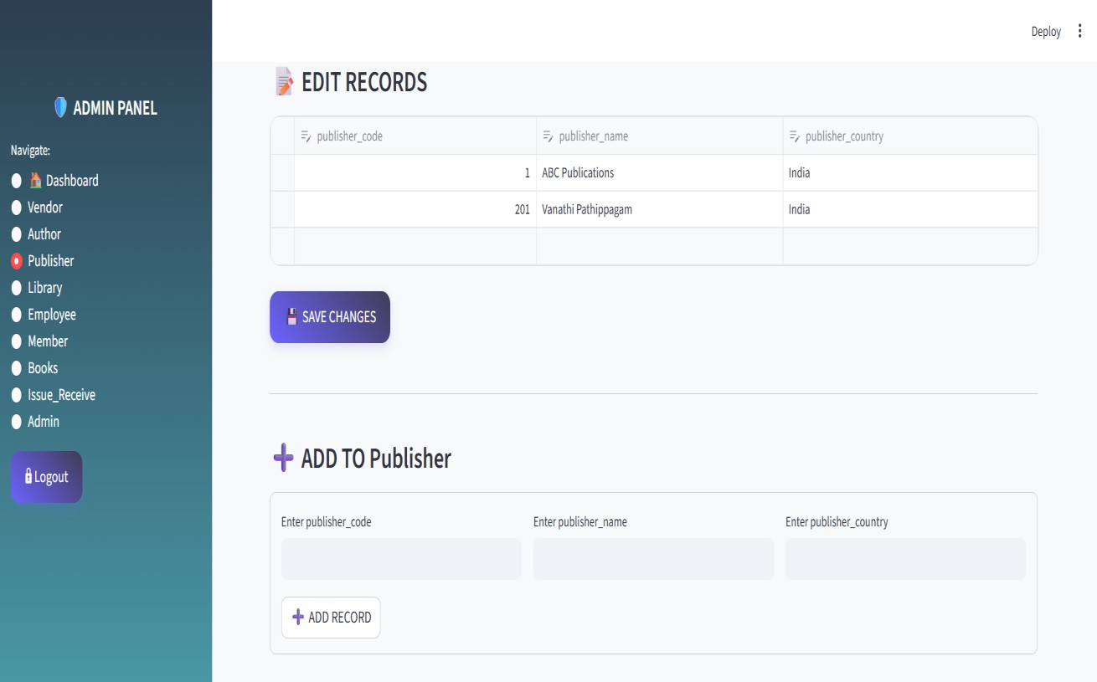
IMPLEMENTATION

Slide 18
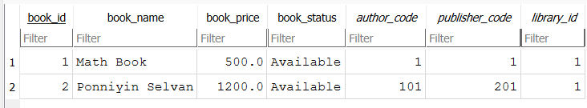
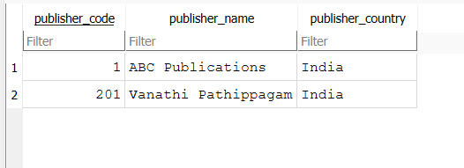
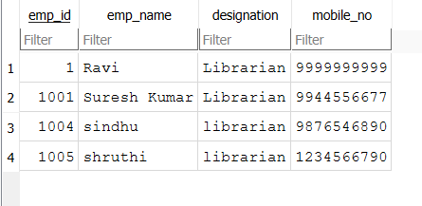
BACKEND DATABASE

Slide 19
CONCLUSION
Library Management System improves record handling
Makes issue and return process easier
Stores data in an organized way
Reduces manual errors
Provides faster access to information

Slide 20
FUTURE SCOPE
Online book reservation
Barcode integration
Fine calculation automation
Email/SMS notification for due dates
Student login portal
Cloud database support
Advanced report dashboard

Slide 21


